Slide 1
Lightning Prerequisite
June 2019

Slide 2
Agenda
Revisiting JavaScript
Data Types
Functions
JS Events
Objects
Inheritance
Revisiting CSS
Overriding default CSS
Cascading
CSS Grid System
Q&A

Slide 3
JavaScript : Data Types
JavaScript is a loosely typed or a dynamic language. That means you don't have to declare the type of a variable ahead of time. The type will get determined automatically while the program is being processed.
Primitive Data Types Boolean Null Undefined String Number Symbol Object | Reference Type Date Array Functions

Slide 4
Primitive Data Types
Undefined – any variable that has been declared but not been assigned a value has the value undefined.
Ex- let abc; // undefined
Null – It’s just a special value which represents “nothing”, “empty” or “value unknown”. The code above states that age is unknown or empty for some reason.
Ex - let myVar = null; // null
Boolean – represents a logical entity having two values called true and false.
Ex - let status = true; // true
String - The String type is the set of all ordered sequences of zero or more 16-bit unsigned integer values (“elements”) up to a maximum length of 2^53-1 elements. The String type is generally used to represent textual data in a running ECMAScript program, in which case each element in the String is treated as a UTF-16 code unit value. Each element is regarded as occupying a position within the sequence.
Ex - let lastName = "Johnson"; // Johnson
Symbol - the set of all non-String values that may be used as the key of an Object property.

Slide 5
Primitive Data Types
Don’t get used often but when used to create pseudo private keys.
Ex - const myAsyncIterable = new Object();
myAsyncIterable[Symbol.asyncIterator] = async function*() {
yield "hello"; yield "async"; yield "iteration!";
};
(async () => { // expected output:
for await (const x of myAsyncIterable) { // "hello"
console.log(x); // "async"
} // "iteration!“
})();
Number - has exactly 18437736874454810627 (that is, 2^64-2^53+3) values, representing the double-precision 64-bit format IEEE 754-2008 values as specified in the IEEE Standard for Binary Floating-Point Arithmetic
Ex - let length = 16;
Object - logically a collection of properties. Each property is either a data property, or an accessor property.
Ex - let x = {firstName:"John", lastName:"Doe"};

Slide 6
Object
Different ways to create new objects:
Define and create a single object, using an object literal.
Define and create a single object, with the keyword new.
Define an object constructor, and then create objects of the constructed type.
In ECMAScript 5, an object can also be created with the function Object.create().
Using an Object Literal
let person = {firstName:"John", lastName:"Doe", age:50, eyeColor:"blue"};
let person = {firstName:"John", lastName:"Doe", age:50, eyeColor:"blue"};
console.log(person.firstName + " is " + person.age + " years old.");
Using the JavaScript Keyword new or Using the Object() constructor:
let person = new Object();
person.firstName = "John"; person.lastName = "Doe";
person.age = 50;person.eyeColor = "blue";
console.log(person.firstName + " is " + person.age + " years old.");

Slide 7
Object
Eg:2
let d = new Object();
This is the simplest way to create an empty object.
let d = new Object(); d.name=“test";console.log(d);
Using Object.create() method:
let a = Object.create(null); a.name='test'; console.log(a);
This method creates a new object extending the prototype object passed as a parameter.
Using a function constructor
let Obj = function(name) {
this.name = name
}
let c = new Obj("hello");
The new operator is calling a function and setting this of the function to a fresh new Object, and binding the prototype of that new Object to the function's prototype.

Slide 8
this Object
It has different values depending on where it is used:
In a method, this refers to the owner object.
Alone, this refers to the global object.
In a function, this refers to the global object.
In a function, in strict mode, this is undefined.
Ex - var person = {
firstName: "John",
lastName : "Doe",
id : 5566,
fullName : function() {
return this.firstName + " " + this.lastName;
}
};
person.fullName();

Slide 9
var v/s let v/s const
Variables declared with the var keyword are said to be in the function scope.
This means that a variable would exist only within the scope of the function in which it was declared. Or the nearest parent function, if it’s a nested function.
Ex- var myVar = 1;
function myFunc() {
var myVar = 2;
console.log(myVar);
}
myFunc(); // 2
console.log(myVar); // 1
A block is any code within curly braces. Block scoping ensures that any variables defined within those braces don’t become global variables. They instead have local scope. Variables assigned with let are always block scoped.
Ex - var myVar = 1;
if (true) { let myVar = 2; console.log(myVar); } // 2
console.log(myVar); // 1

Slide 10
var v/s let v/s const
ES6 also introduced another keyword, const.
This can be useful when you need to declare a variable that cannot be redeclared or reassigned.
Ex – const BRANDCOLOR;
console.log(BRANDCOLOR);

Slide 11
JavaScript : Functions(Named, Anonymous, Arrow ,IIFE)
Functions are first class objects
Functions can be passed, returned and stored just like any other value. [Very powerful.]
Functions inherit from Object and can store name/value pairs.
Functions objects are linked to Function.prototype, which is linked to Object.prototype
Examples
Eg:1 - Function declaration
function isEven(num) {
return num % 2 === 0;
}
isEven(24); // => true
Eg:2 – Function Expression
let myTeacher = function anotherTeacher() { console.log(anotherTeacher); };
Syntax:
function [name]([param1[ = defaultValue1 ][, ..., paramN[ = defaultValueN ]]]) {
statements
}

Slide 12
Named Function
When a function expression has name.
Ex- let keyHandler = function keyHandler() { → Function Expression
/* … */ }
function isEven(num) { → Function Declaration
return num % 2 === 0;
}
Why? to use named function
The name produces a reliable function self-reference (recursion etc).
More debuggable stack traces.
More self-documenting code

Slide 13
Anonymous Function
An anonymous function is a function that was declared without any named identifier to refer to it. As such, an anonymous function is usually not accessible after its initial creation.
Ex - let count = function(array) { // Function expression
return array.length;
};
console.log(count([5, 7, 8])); // => 3
Ex - 2
let methods = {
numbers: [1, 5, 8],
sum: function() { // Function expression
return "hi i am inside";
}
};
console.log(methods.sum()); // => 14

Slide 14
Immediately-invoked Function Expression (IIFE)
A way to execute functions immediately, as soon as they are created.
A self-invoking expression is invoked (started) automatically, without being called.
Function expressions will execute automatically if the expression is followed by ().
IIFEs are very useful because they don't pollute the global object, and they are a simple way to isolate variables declarations.
Ex - (function () {
console.log("Hello! I called myself“);
})();
let result = (function () {
let name = "Barry";
return name;
})();
console.log(result);

Slide 15
Arrow Functions
ES6 introduced a shorter way to define functions using what is called arrow functions.
Arrow functions result in less code and remove some of the confusion when dealing with the this keyword, especially when nested functions are involved.
Example
let result = (i,j) => i+j;
console.log(result(2,3));

Slide 16
Types of JavaScript Pattern
Categorized based on “this”
Type of Invocation
Method invocation pattern
Function invocation pattern
Constructor invocation pattern
Indirect invocation pattern

Slide 17
Method invocation
In JavaScript, any function that is part of an object is known as a method or When we define a JavaScript function as a property of object then function is known as Method.
Assume we have a JavaScript object studentObject as in the following. In the studentObject object, the findgrade property is a function. So we can say findgrade is a method.
let studentObject = { name: "dj", marks: 89, findgrade: function (marks) { if (marks > 75) { return "Grade A "; // this.grade = "A"; } else { return "Grade B "; // this.grade = “B"; } } } Invocation of a method is known as "Method Invocation Pattern". We can invoke a method using the dot operator on the object. The method can be invoked as in the following:
let grade = studentObject.findgrade(99); console.log(grade);

Slide 18
Function Invocation Pattern
When you call a function as an expression then it is known as a Function Invocation Pattern. Let us say you have a function as given below:
function FindSquare(number) { return number * number; } You can invoke the function above as below: let result = FindSquare(9); console.log(result); This way or pattern of invoking a function is called a Function Invocation Pattern. There are a few important points of the function invocation pattern as follows:
First, each parameter is evaluated and then passed as an argument to the function
The function returns either a value or undefined to the LHS variable. If called, a function that does not have a return value returns undefined.

Slide 19
Constructor Invocation Pattern
If you invoke a function with the new keyword, then it is a Constructor Invocation Pattern. For Ex -, in the following we are invoking a constructor:
let obj = new String(); let obj2 = new Object();
Arguments to constructors will be passed in the same way as a Function Invocation Pattern. There could be a scenario when the constructor does not require any parameters. Then in that case the constructor can be called without braces. let obj2 = new Object;
Constructor invocation creates an empty object that inherits from the prototype property of the constructor.
The constructor function usually does not have a return. This is used to initialize a new object. It always returns a new object. Even if the constructor has a return statement with some primitive values, the return statement will be ignored and a new object will be returned.
Example
let Car = function(initialState){
this.isRunning = initialState;
};
Car.prototype.start = function(){
this.isRunning = true;
};
Car.prototype.stop= function(){
this.isRunning = false;
}

Slide 20
Constructor Invocation Pattern
When a function is invoked using the new prefix, JS changes the behavior of how the function is executed.
a) It creates an empty object.
b) It adds the properties defined using the “this” keyword to the empty object.
c) Creates a hidden link to the prototype of this new object and returns this
d) The hidden link cannot be modified after creation of the object using the new operator. Note: There is a non-standard link __proto__. Don’t use this. As far as we are concerned, we can’t modify the prototype after using the new operator on functions.

Slide 21
Constructor
let c1 = new Car(false);
let c2 = new Car(true);
c1.start() //c1 has a hidden link to its prototype.
c2.stop() //c2 has a hidden link to its prototype.
Note: There is no prototype property on the new object that has been made. Only the constructor has it. It vanishes upon using the Constructor function with the new operator

Slide 22
Indirect Invocation Pattern
We can execute a JavaScript function indirectly using a function's method as well. There are three function methods used to execute a JavaScript function indirectly. They are as follows:
Call() method
Apply() method
call() and apply() serve the exact same purpose.
The only difference between how they work is that call() expects all parameters to be passed in individually, whereas apply() expects an array of all of our parameters.

Slide 23
Invocation pattern
let pokemon = {
firstname: 'Pika',
lastname: 'Chu ',
getPokeName: function() {
let fullname = this.firstname + ' ' + this.lastname;
return fullname;
}
};
let pokemonName = function(snack, hobby) {
console.log(this.getPokeName() + ' loves ' + snack + ' and ' + hobby);
};
pokemonName.call(pokemon,'sushi', 'algorithms'); // Pika Chu loves sushi and algorithms
pokemonName.apply(pokemon,['sushi', 'algorithms']); // Pika Chu loves sushi and algorithms

Slide 24
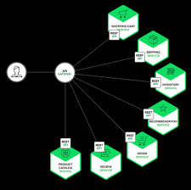

JavaScript: Events and Event Handling
Programs that can capture and respond to events are called ‘event-driven programs’
JavaScript was specifically designed for writing such programs
Almost all programs written in JavaScript are event-driven
Events make web applications more responsive, dynamic and interactive programming by callbacks
Events allow scripts to respond to user's interactions with elements on a web page can initiate a modification of the page

Slide 25
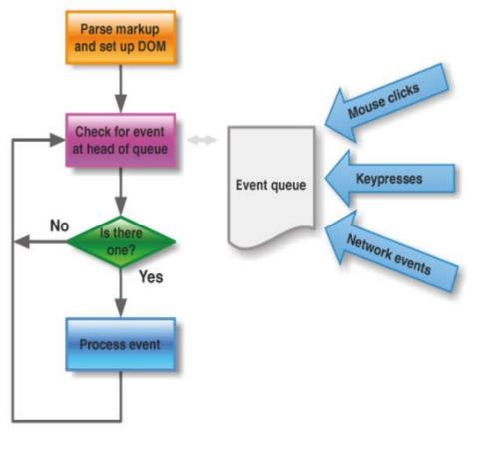
Event Handlers
Event handler
function that is called in when an event occurs
typically associated with an XHTML element
must be registered
i.e., the association must be specified
Event handler registration
two methods
inline
programmatically (traditional method)

Slide 26
Inline Registration
Inline registration specifies JS code to be executed when an event occurs directly in the attribute of an XHTML element
attribute name corresponds to the event
e.g., onclick="…", onload="…"
attribute value is the JS code
typically call of the event handler function
e.g., onload="init()"
but can be a any sequence of JS statements
e.g., onclick="move();score();feedback()"

Slide 27
Programmatic Registration
Programmatic registration assigns a handler within JS code
Ex - document.getElementById("myBtn").onclick = displayDate;
Other few Event examples
document.getElementById("myFrame").addEventListener("load", myFunction);
document.getElementById("fname").addEventListener("focus", myFunction);
document.getElementById("fname").addEventListener("blur", myFunction);

Slide 28
Event and this
An event consists of three pieces of information
name of the event
element to which it was delivered
an event object
Name is implicit
you know which handler was called
Associated element
inside the handler, this refers to the element
you can use the same handler for different elements
then you can differentiate by the id of this element
Event object
stores contains additional event information

Slide 29
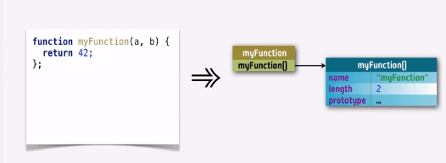
Prototype
Every object you create has a “secret” link to its prototype.
Objects created using the Object literal {} are linked to Object.prototype.
Note: Object.prototype comes out-of-box with JavaScript.
SO, How can I create an object by specifying its prototype?
Answer : We need to know how prototypal inheritance is implemented in JS. However, let’s assume we have a method on Object.prototype called “create”, which allows you to specify the prototype of an object.

Slide 30
Prototypal class Example
function Workshop(teacher) {
this.teacher = teacher;
}
Workshop.prototype.ask = function(question) {
console.log(this.teacher, question);
};
let deepJS = new Workshop(“abcd”);
let reactJS = new Workshop(“defg”);
deepJS.ask(“Is ‘prototype’ a class?”);
// abcd Is ‘prototype’ a class?
reactJS.ask(“Isn’t ‘prototype’ ugly?”);
// defg Isn’t ‘prototype’ ugly?

Slide 31
Pseudoclassical Inheritance Example
function Workshop(teacher) {
this.teacher = teacher;
}
Workshop.prototype.ask = function(question) {
console.log(this.teacher, question);
};
function AnotherWorkshop(teacher) {
Workshop.call(this, teacher);
}
AnotherWorkshop.prototype = Object.create(Workshop.prototype);
AnotherWorkshop.prototype.speakUp = function(message) {
this.ask(message.toUpperCase());
};
let JSRecentParts = new AnotherWorkshop(“abcd”);
JSRecentParts.speakUp(“is this actually inheritance?”)
// abcd is this actually inheritance?

Slide 32
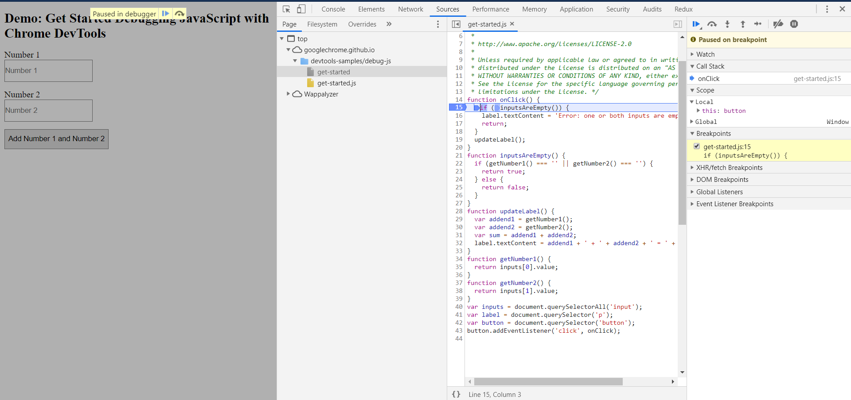
Debugging JavaScript in ChromeDevTools
Steps
Open DevTools using F12/Ctrl+Shift+I
Reproduce the bug
Get familiar with the Sources panel UI
Pause the code with a breakpoint
Step through the code
Set a line-of-code breakpoint
Check variable values
Apply a fix
https://developers.google.com/web/tools/chrome-devtools/
Other Useful thing
Inspect and Edit Pages
Remote Debugging
Fix Memory Problems
Monitor Network Connections
Mobile Simulation

Slide 33
CSS: Introduction
Cascading Style Sheets describes the look and feel of a web page including layout, design and variation of display depending on screen sizes.
Eg: p { color: red; text-align: center; }
Ways of Inserting CSS in a Webpage:
External style sheet
Internal style sheet
Inline style

Slide 34
CSS : External Style Sheet
HelloWorld.html(WebPage):
<head>
<link rel="stylesheet" type="text/css" href="mystyle.css">
</head>
<body>
<h1>Lightning Training</h1>
</body>
mystyle.css(Stylesheet):
body { background-color: lightblue; }

Slide 35
CSS : Internal Style Sheet
HelloWorld.html(WebPage):
<head>
<style>
body { background-color: lightblue; }
</style>
</head>
<body>
<h1>Lightning Training</h1>
</body>

Slide 36
CSS: Inline Sheet
HelloWorld.html(WebPage):
<head>
</head>
<body style=“background-color: lightblue;”>
<h1>Lightning Training</h1>
</body>

Slide 37
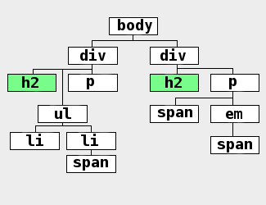
CSS : Styling your page
.
Single element type:
Multiple element types:
All element types:
Specific elements by id:

Slide 38
CSS : Cascading
Inheritance
The idea behind inheritance is relatively easy to understand. Elements inherit styles from their parent container. If you set the body tag to use color: red then the text for all elements inside the body will also be red unless otherwise specified.
Not all CSS properties are inherited, though.
When multiple styles or style sheets are used, they start to cascade and sometimes compete with one another due to CSS’s inheritance feature. Any tag on the page could potentially be affected by any of the tags surrounded by it.
So, which one wins? Nearest Ancestor Wins.
Inline style or directly applied style
The last style sheet declared in the <header> section

Slide 39
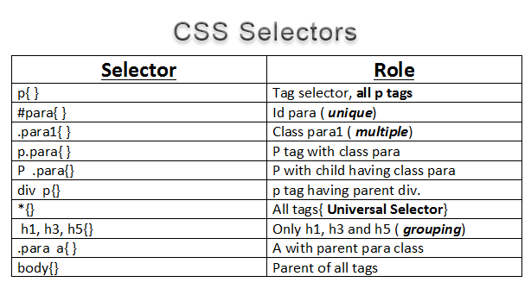
CSS : Cascading

Slide 40
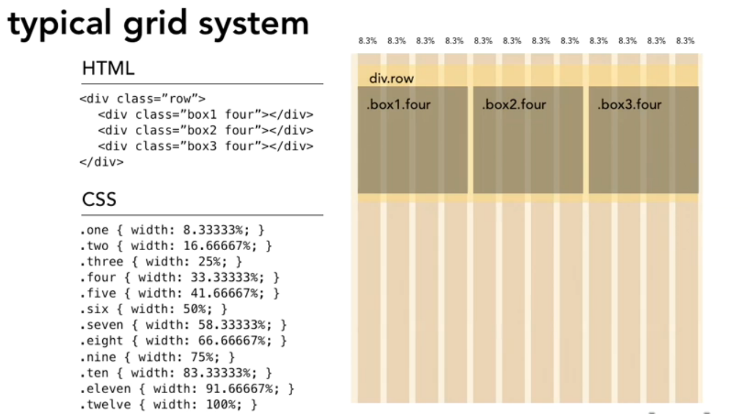
CSS : Grid System
What is a Grid System??
It is a layout mechanism in the css where the whole page is divided in to rows and columns, and then HTML components are floated on the top of the grid to create a layout for the page.

Slide 41
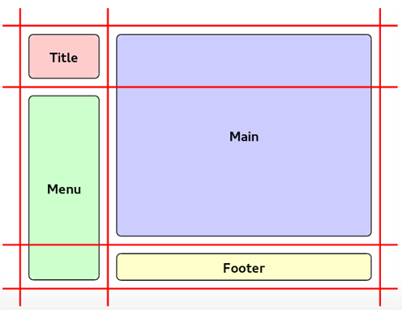
Grid System – Grid lines & Grid Track
Grid lines are the horizontal and vertical dividing lines of the grid.
A grid line exists on either side of a column or row. They can be referred to by numerical index, or by an author-specified name.
Grid track is a generic term for a grid column or grid row—in other words, it is the space between two adjacent grid lines.
Adjacent grid tracks can be separated by gutters or alignment spacing, but are otherwise packed tightly.

Slide 42
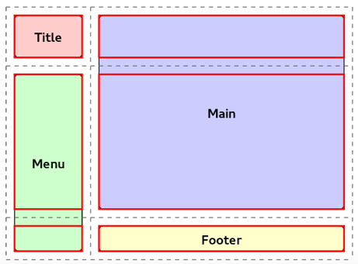
Grid System: Grid Cells
Grid cells are the smallest components of the grid system.
They are made from following css attributes
Grid-row
Grid-column
Example :
.grid-item {
grid-row: 500 / 1500;
grid-column: 2000 / 3000;
}

Slide 43
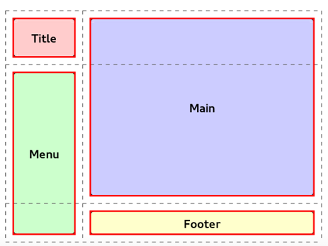
Grid System: Grid Areas
A grid area is the logical space used to lay out one or more grid items.
It is bound by four grid lines, one on each side of the grid area, and participates in the sizing of the grid tracks it intersects.
A grid area can be named explicitly using the grid-template-areas property of the grid container, or referenced implicitly by its bounding grid lines.
A grid item is assigned to a grid area using the grid-placement properties.

Slide 44
Grid System: Example
https://jsfiddle.net/b2epdcc0/1/

Slide 45
References
JavaScript
https://www.w3schools.com/
CSS
https://www.w3schools.com/
CSS : Grid :
http://gridbyexample.com/examples/

